Slide 1

TRELLO PROJECT MANAGEMENT
FALL 2021 CAPSTONE PROJECT: CENTER OF EXCELLENCE

Slide 2

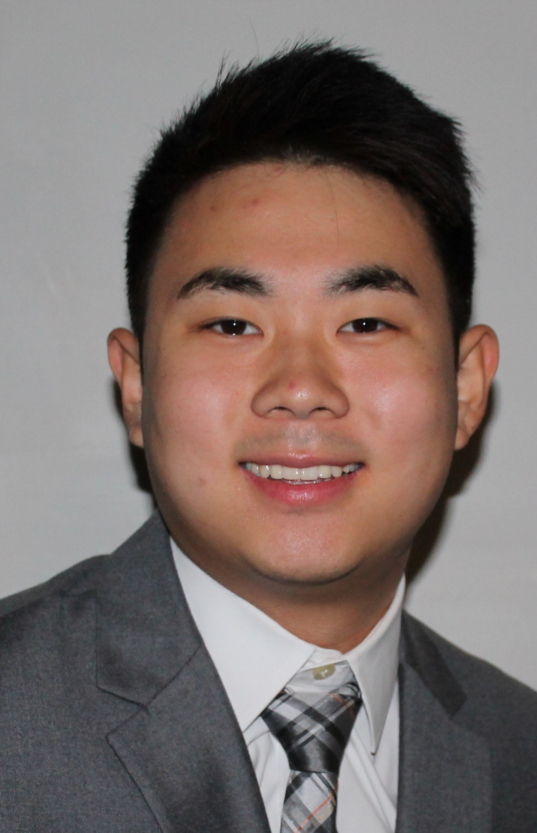

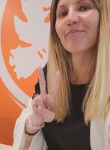
Introduction
Exporting Trello Data for Organization – Aditya Bagchi
Existing Data Analysis & Interpretation – Daniel Park
Trello Engagement Survey & Report – Angel Vo
Sponsor - Justyna Grinholc

Slide 3


Project Description
Managed Trello so it was easy and efficiently used by students and sponsors
In order to help all teams stay organized, there were various individual and collective meetings
Analyzed data from Qualtrics Surveys, COE Existing Database, & Trello in order to create a visualization of the efficiency and usage throughout the semester
Final Deliverables: Tree Template, Training Manual, Graphs & Infographic

Slide 4

Approach & Methodology
Created a plan on how to execute specific parts
Conducted meetings with all team leads and sponsors
Assigned specific roles to each other
Contacted and networked with people for our project
Assisted each other out for specific roles

Slide 5

Project Accomplishments
Successfully used and implemented a collaboration tool that organizes our project into a board (Trello)
Created some key deliverables that will be essential for the new group of Capstone students
Created a Project Plan that laid out a road map that was critical for our journey throughout the semester
Successfully learned how to operate as a team

Slide 6
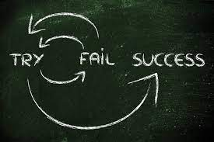
Lessons Learned
How projects are managed in a timely manner
Teamwork is essential for projects
Various tools such as: Tableau, Zapier, Teams, Qualtrics Survey
Understanding the final goal of a project from the very beginning
Learning how to set boundaries

Slide 7
Feedback & Suggestions
Budget
Learning a new tool while teaching that tool has its difficulties
Realistic feasibility
Would've been nice if we had what we created for the next group of Capstone students

